Slide 1
Batch GG

Slide 2
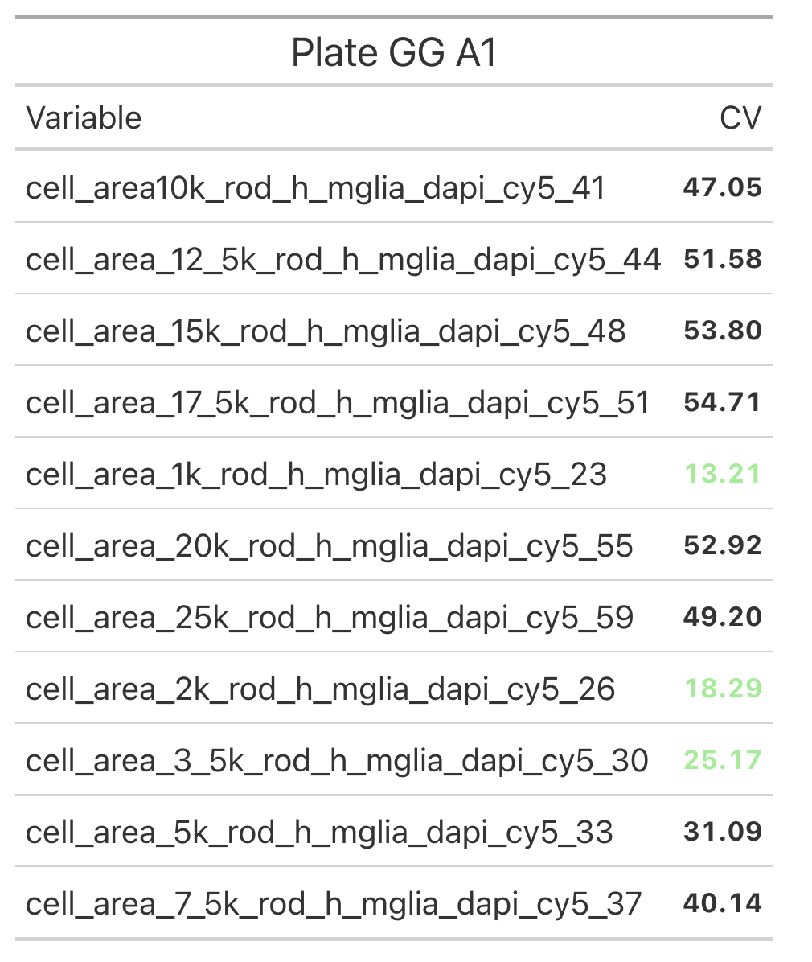
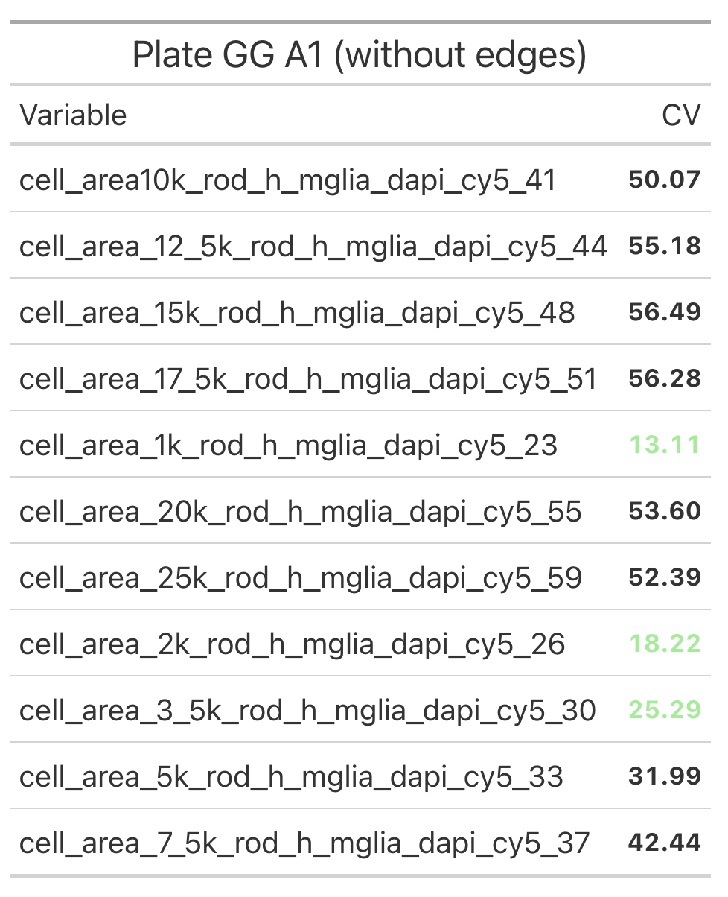
A1: CV

Slide 3
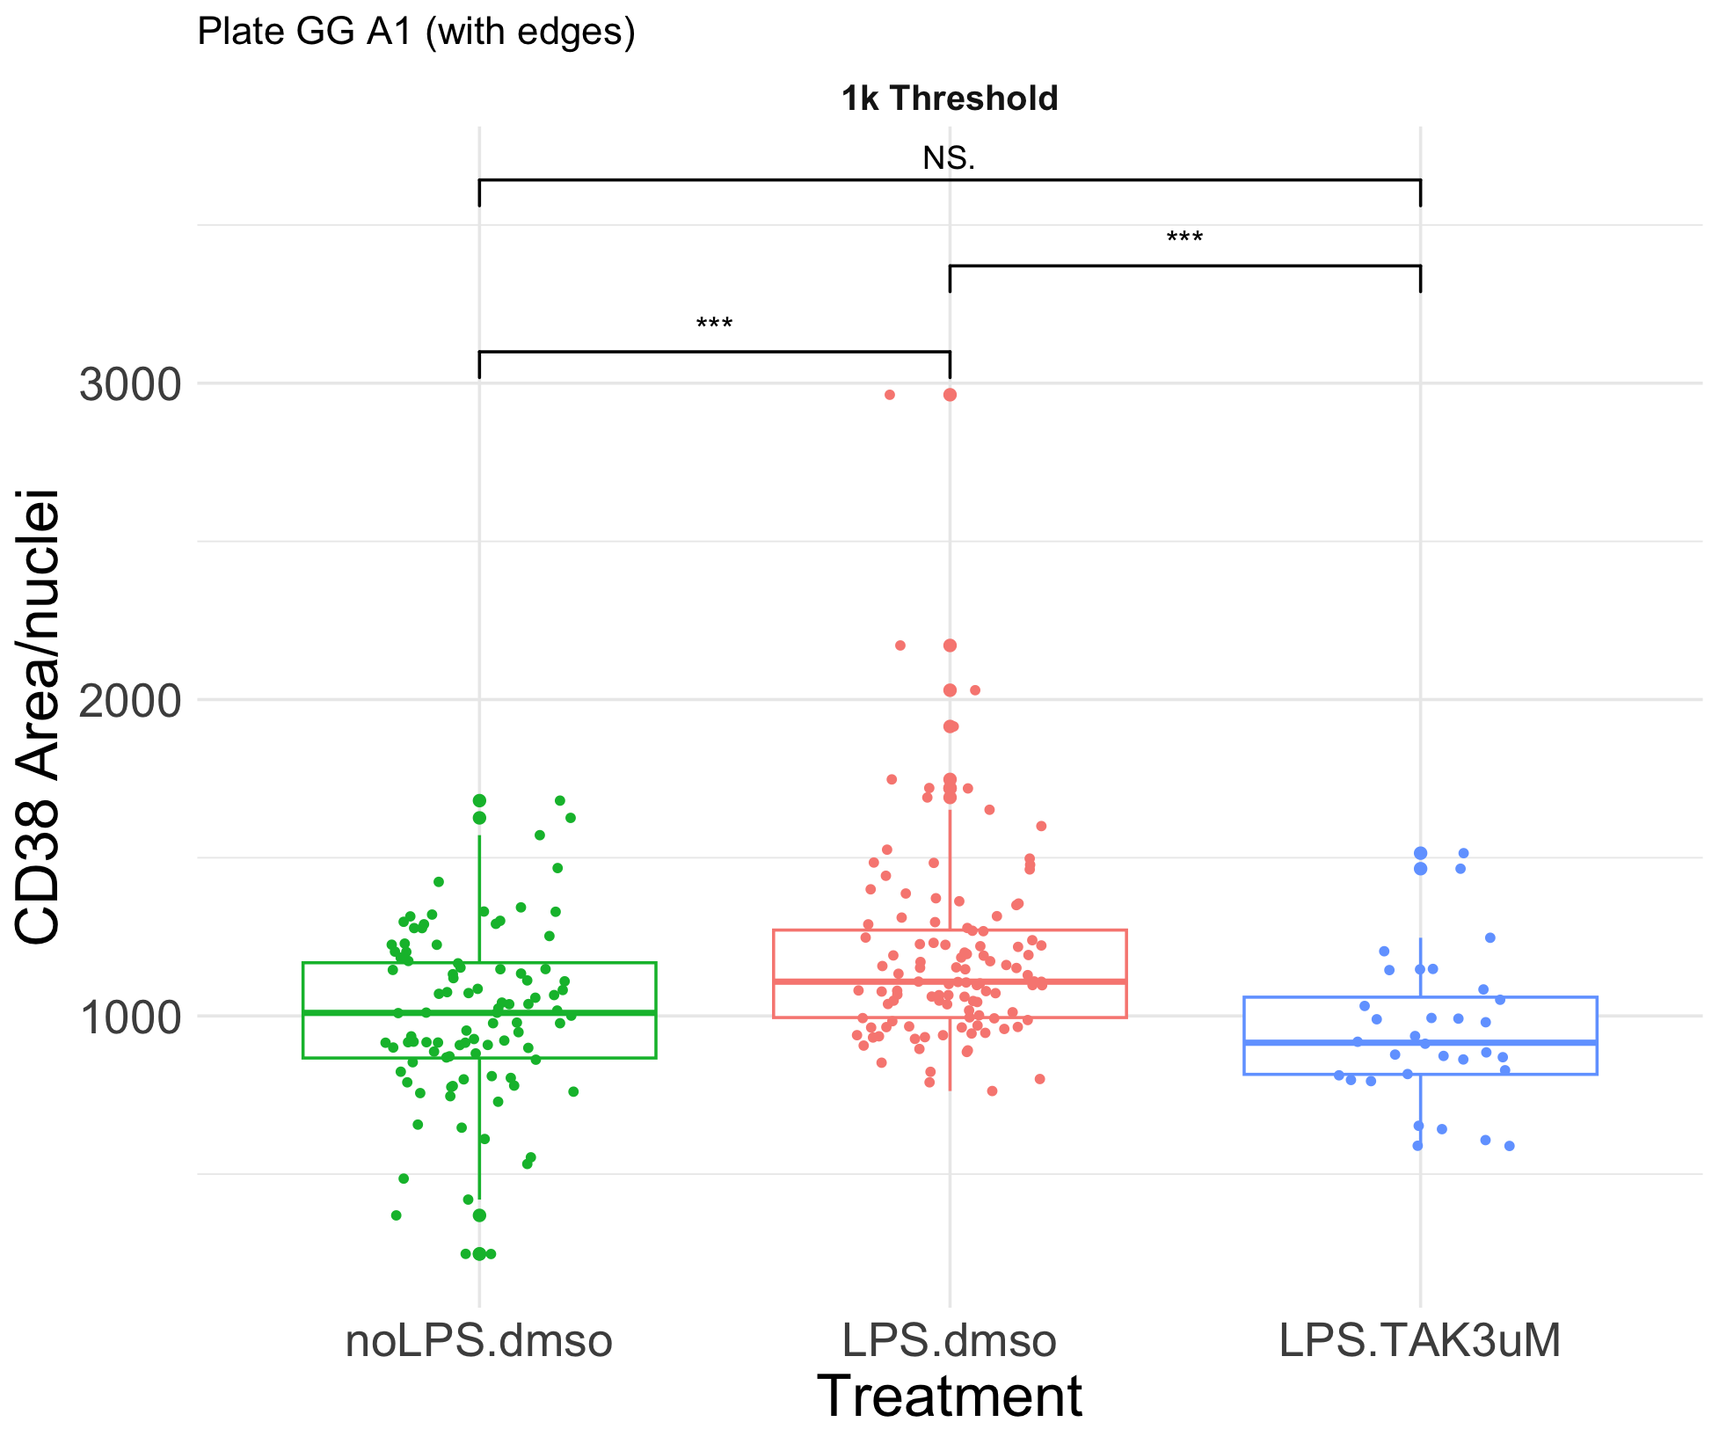
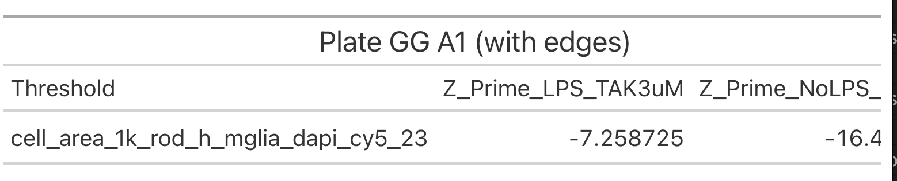
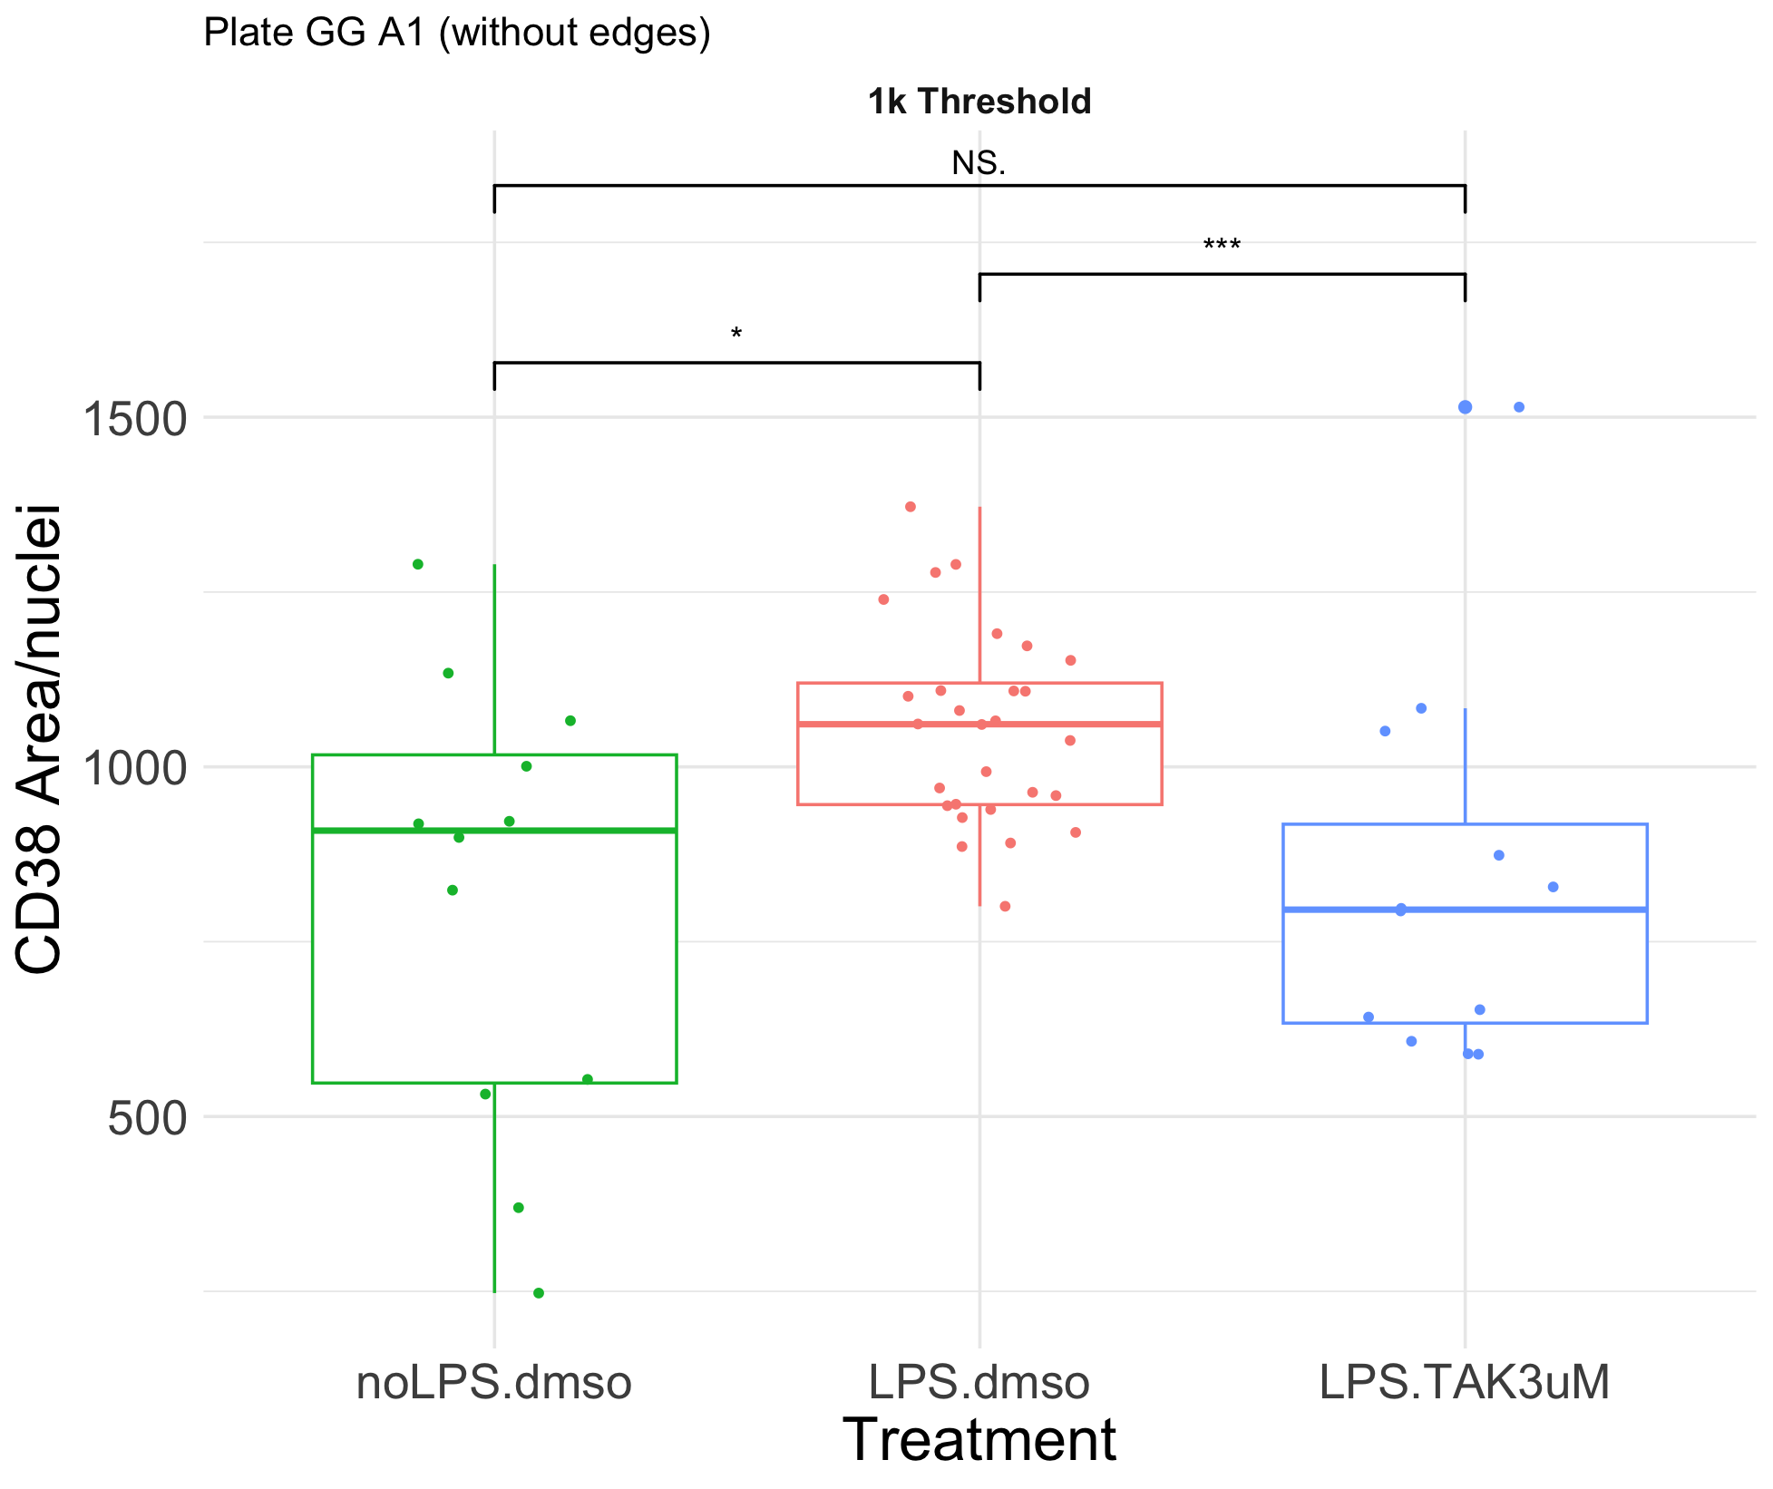
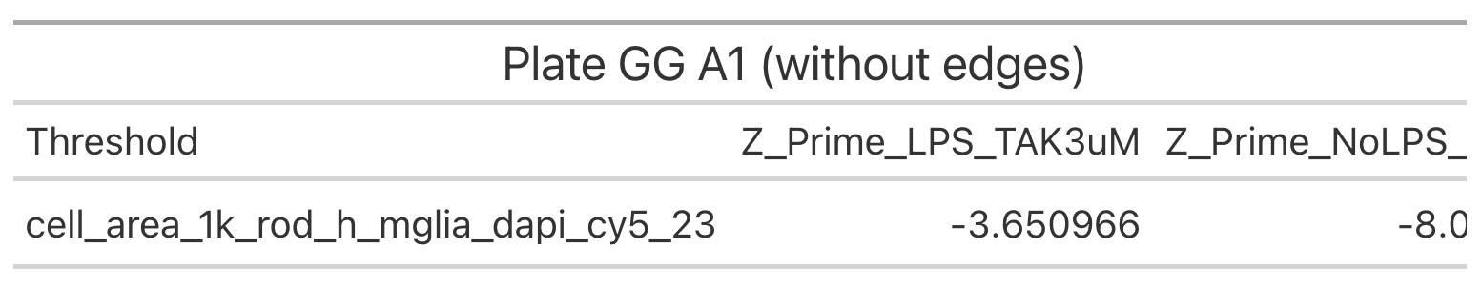
A1: Testing out the assay

Slide 4
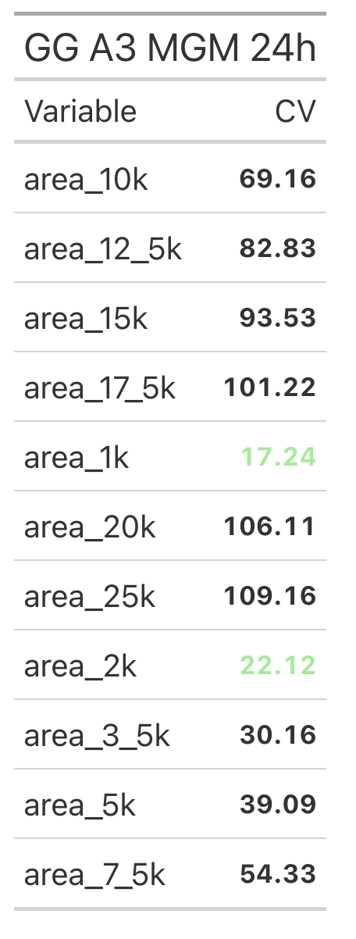
A3: CV

Slide 5
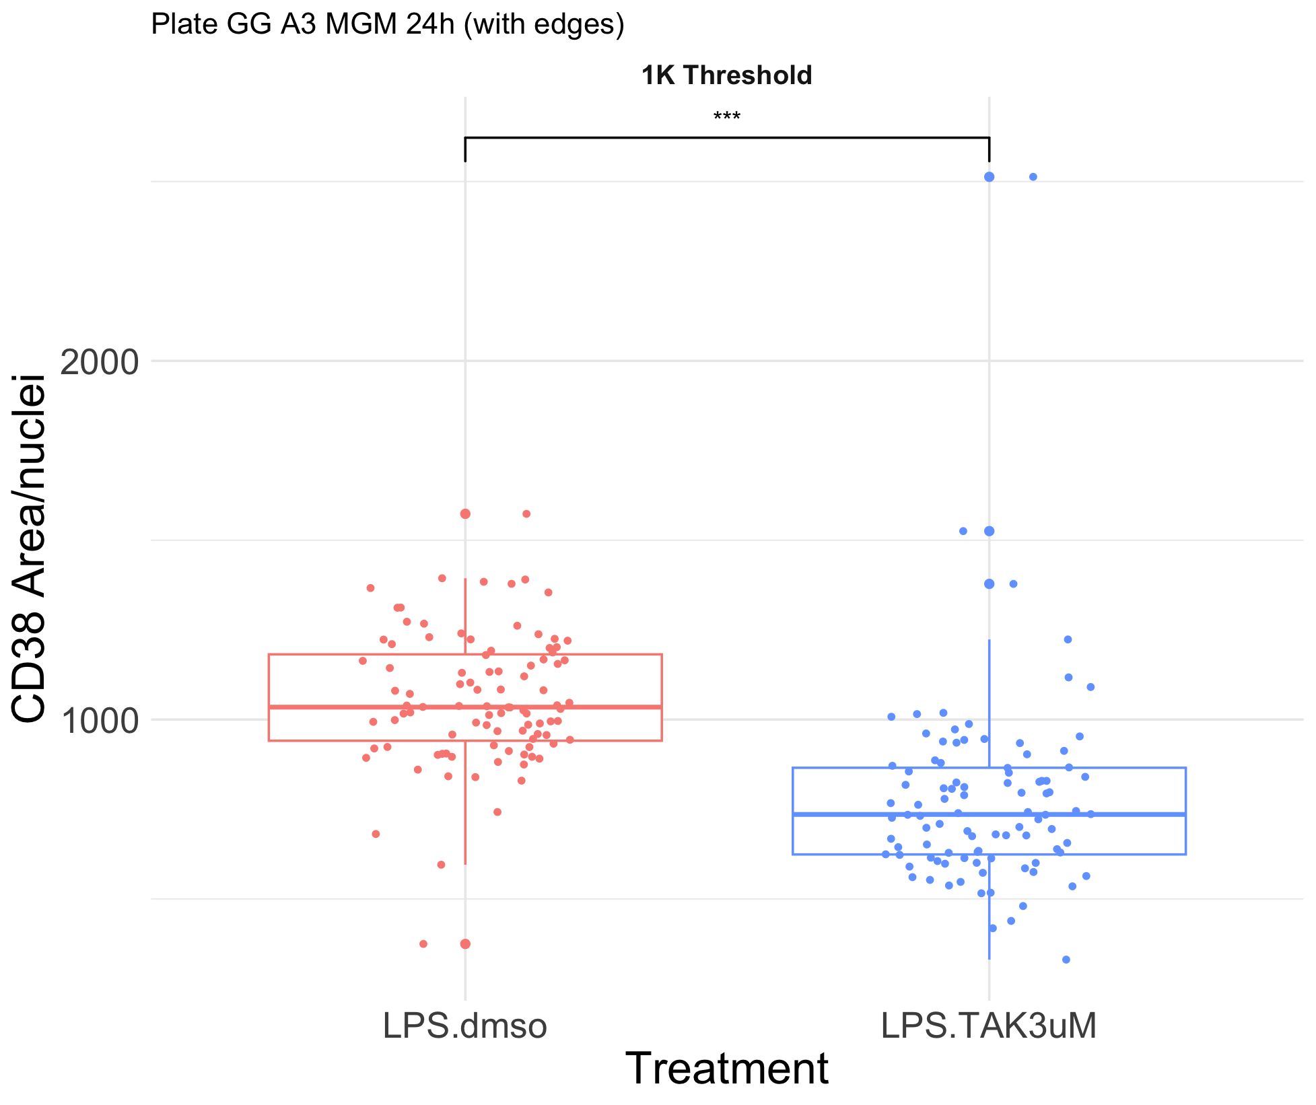
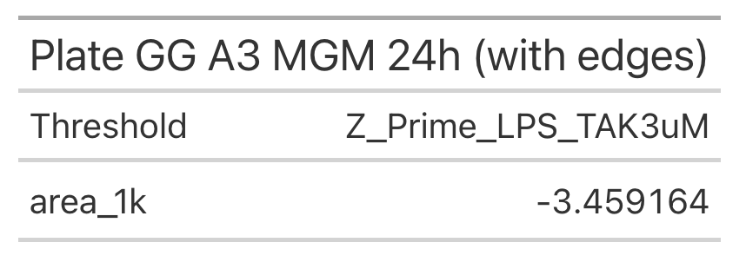
A3: Testing out the assay

Slide 6
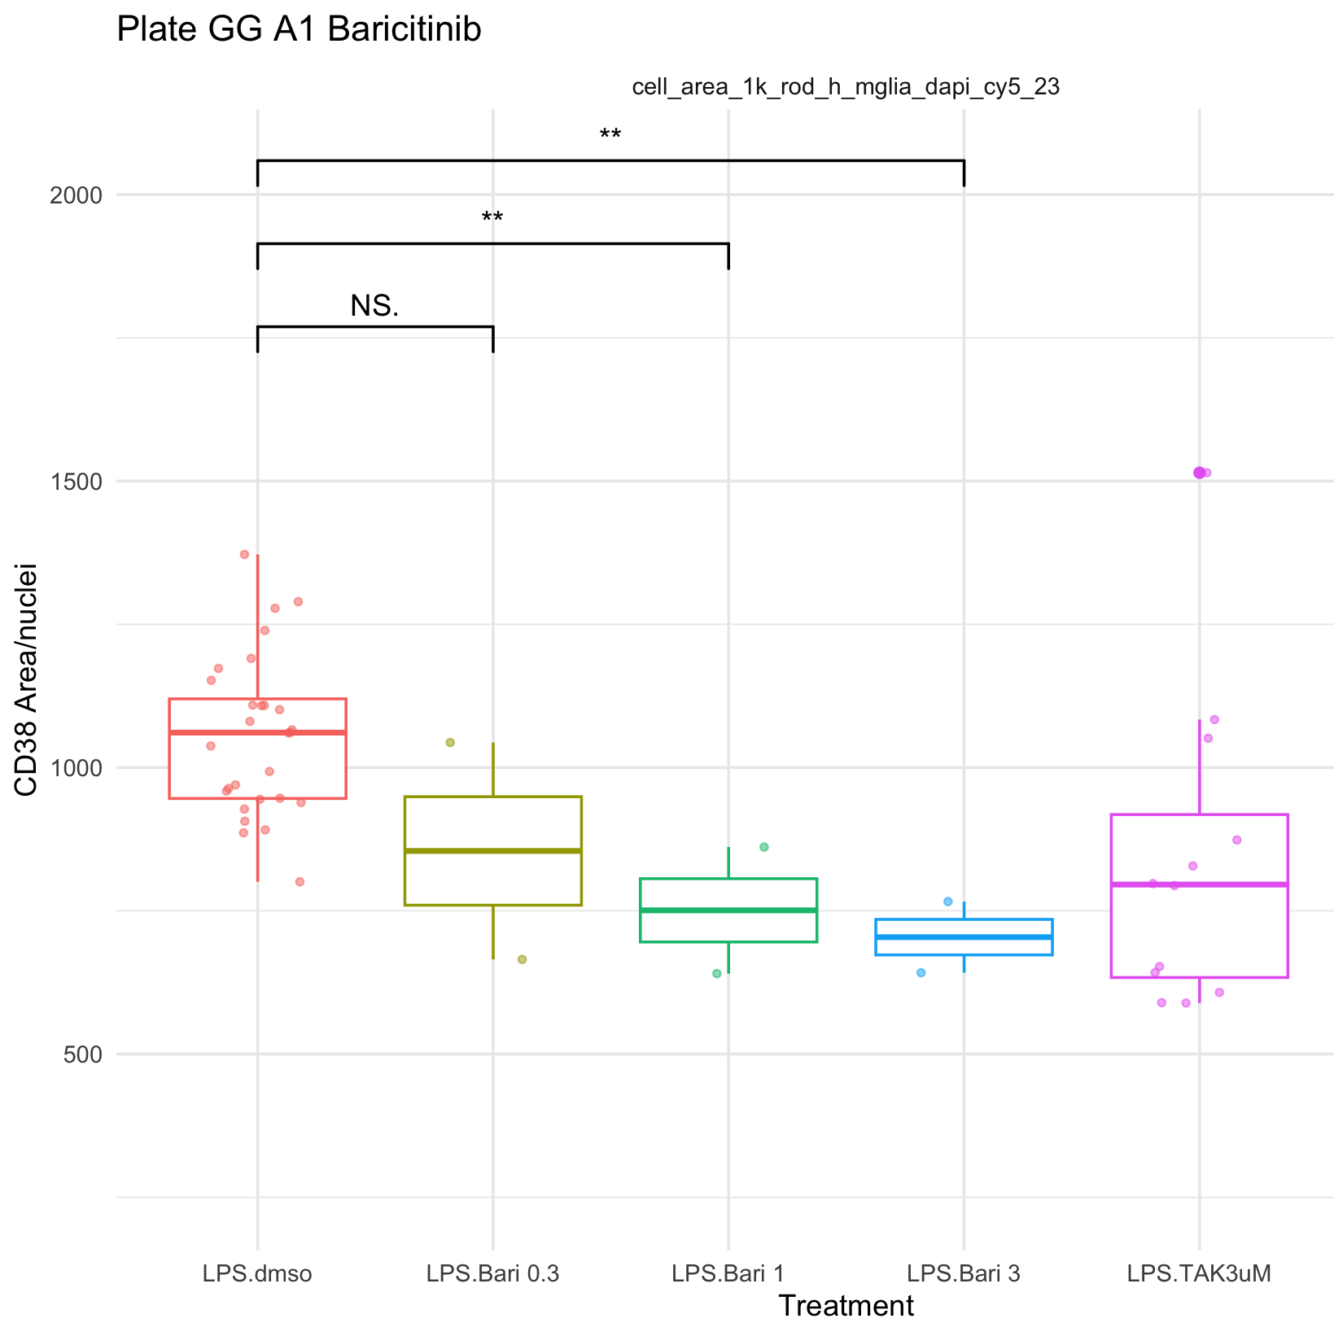
A1: Bari

Slide 7
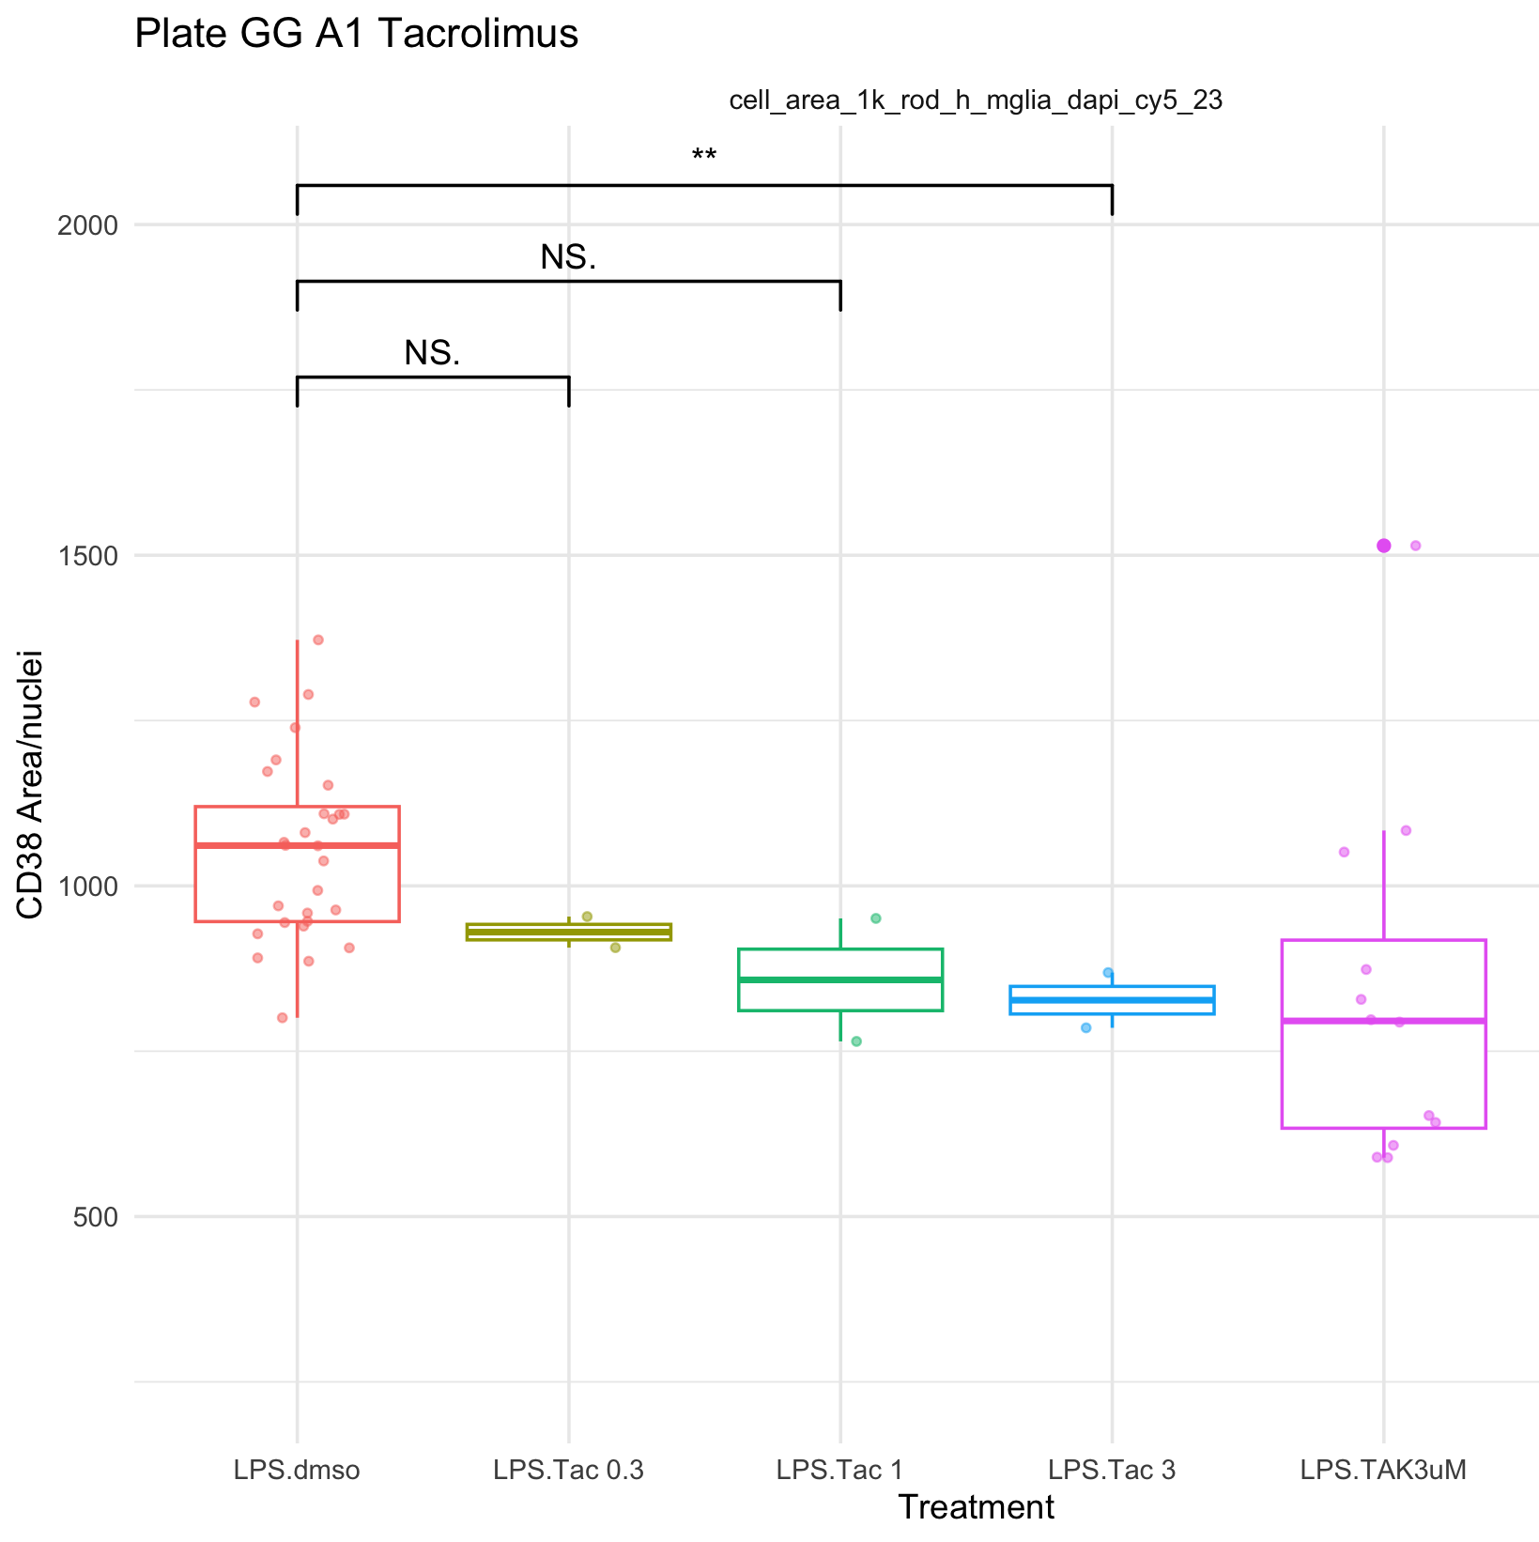
A1: Tacro

Slide 8
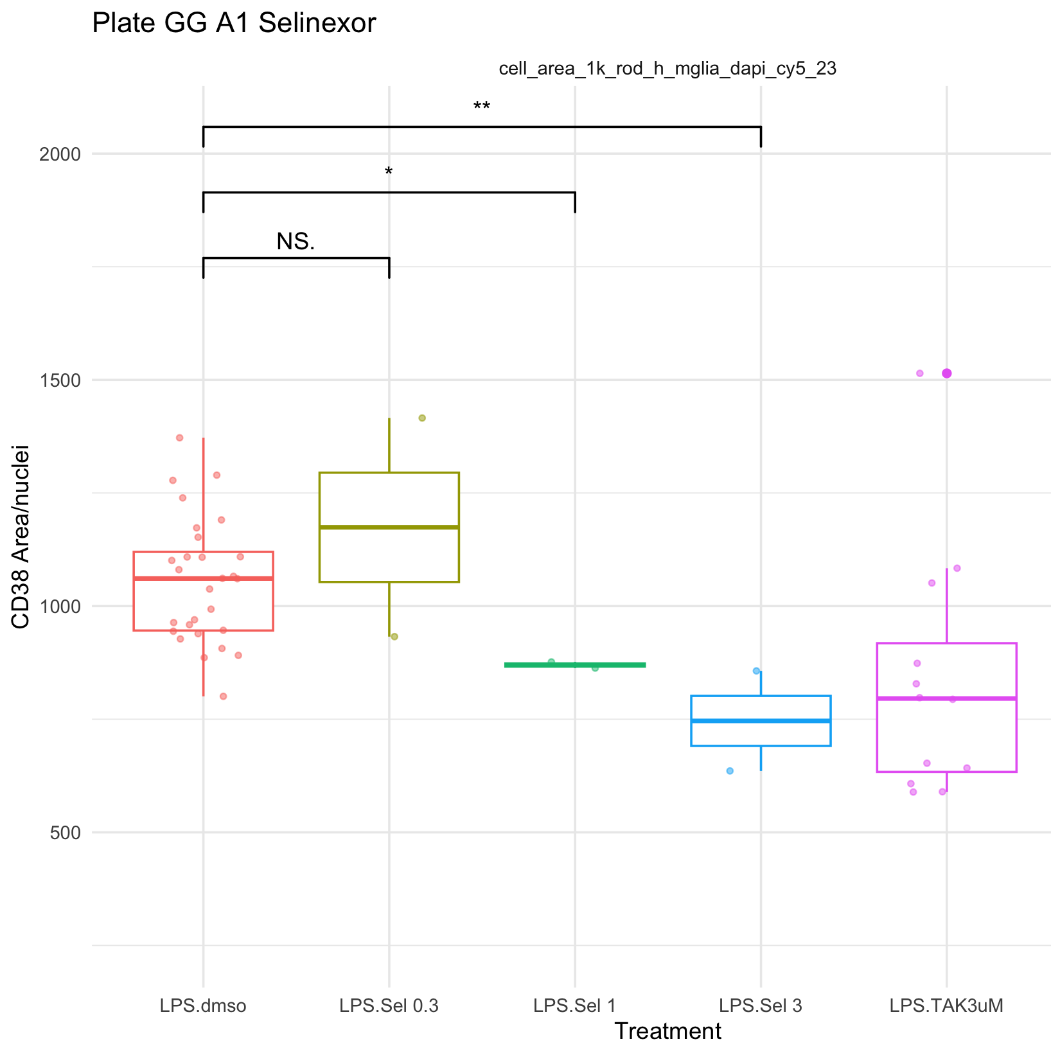
A1: Seli

Slide 9
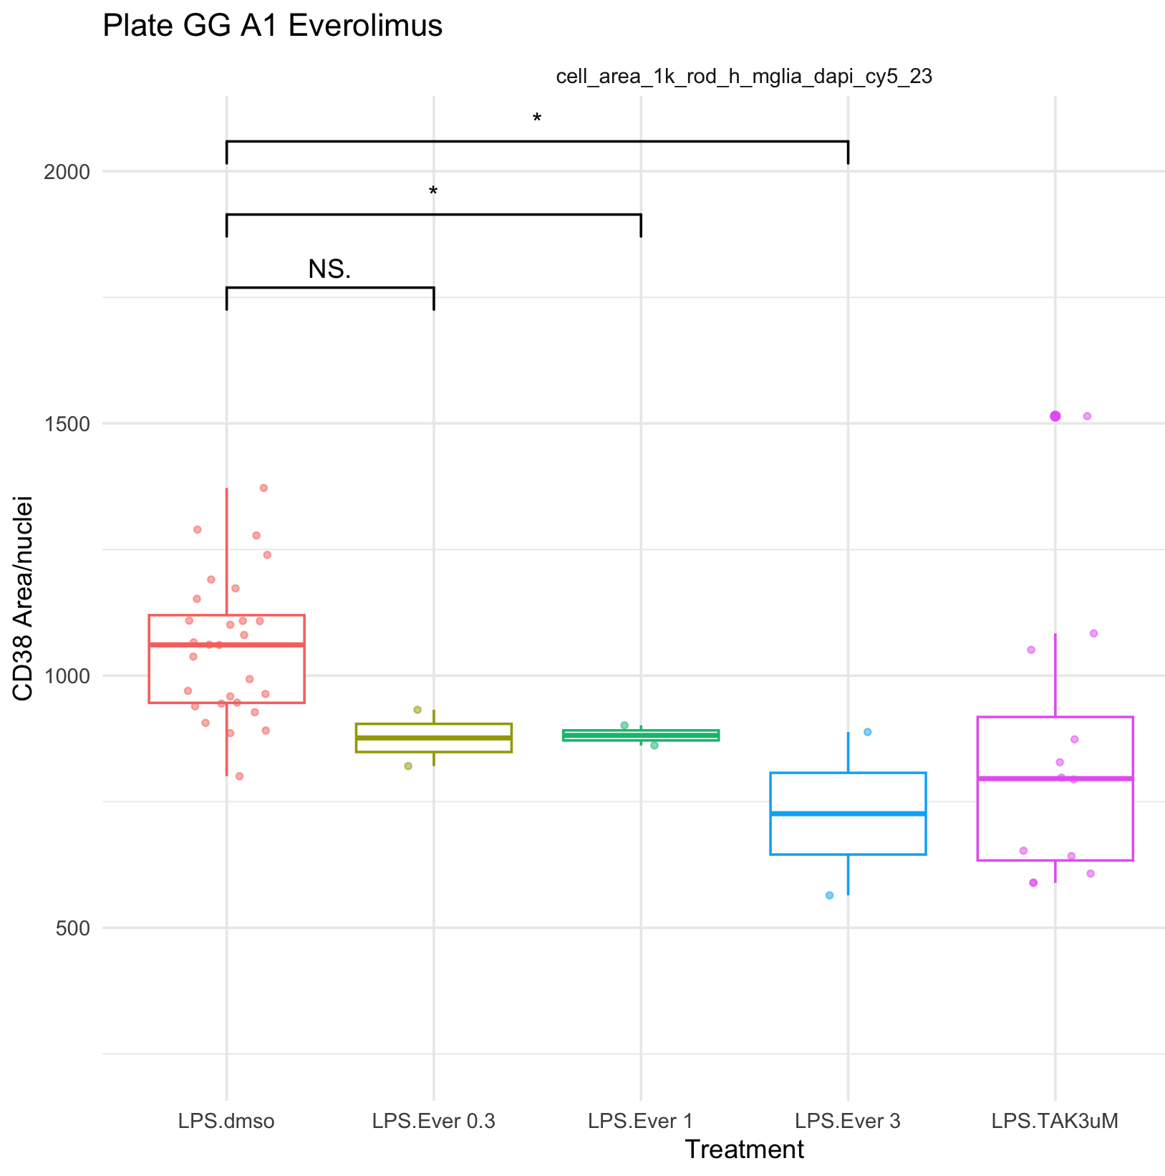
A1: Evero

Slide 10
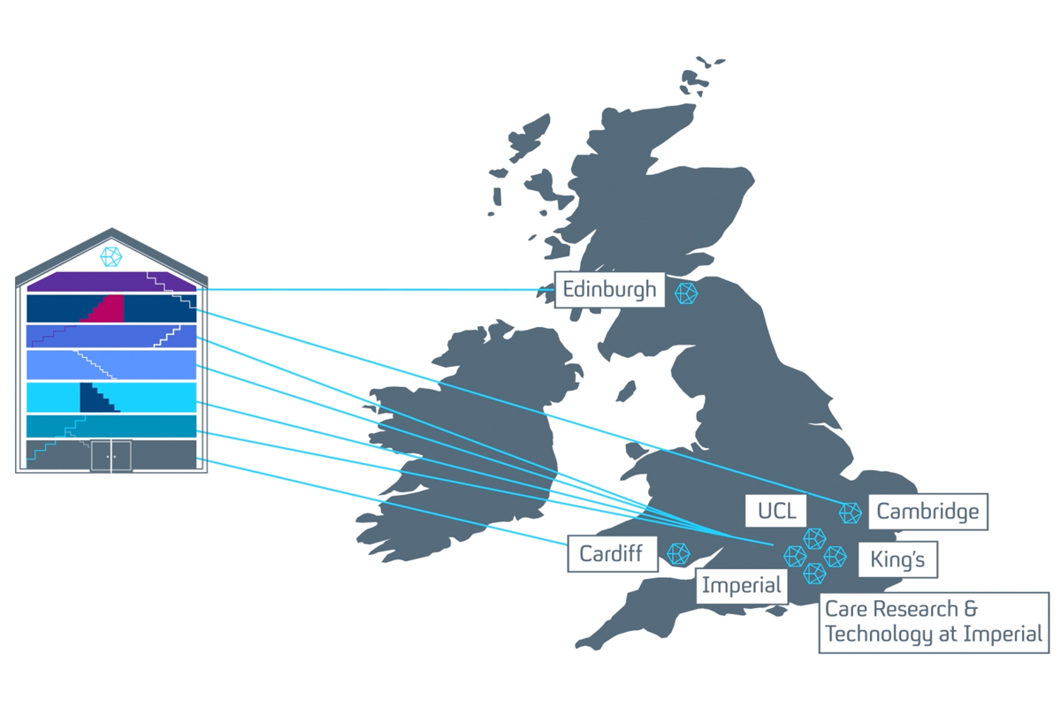
Main header / Question / Conclusion (Arial – 28 – navy)
Short example sentences which can be highlighted in bold or highlight colours. (Arial – 18 – navy)
Sample bullet point title (Arial – 18 – navy)
Bullet points are ‘sky blue’ and this can be customised under ‘Bullet points and numbering’
Sample bullet point 2 (Arial– 16 – navy)
Sample bullet point 1 (Arial – 16 – navy)

Slide 11

Thank you for listening
Name Position Contact email or Slack details
Name Position / Role
Name Position / Role
Name Position / Role
Name Position / Role
Collaborator institution Name (Position / Role) Name (Position / Role) Name (Position / Role)
Collaborator project Name (Institution) Name (Institution Name (Institution

